Slide 1
COUNTYWIDE FIRE & RESCUE SERVICES STUDY
COMMISSIONED BY:
The Civic League of the Halifax Area
For a copy of this presentation and the full report
go to:
www.CivicLeagueHalifaxArea.org

Slide 2
Why this study?
Local government revenues are shrinking
We have 13 separate fire/rescue agencies with unnecessary duplication
A 2002 TriData study foreshadowed economies of scale
Fire Chiefs Association 2005 Report: CONSOLIDATION = ECONOMIES

Slide 3
Why this study?
5. A non-partisan study for the welfare of the County fits the mission of the Civic League

Slide 4
Glossary
Fire/Rescue: Fire Department responders
EVAC: EVAC Transport Responders
EMS: Emergency Medical Services from either EVAC or fire/rescue
ALS: Advance Life Support (paramedics)
BLS: Basic Life Support (EMTs)

Slide 5
Glossary
Dependent District: Can function under existing County government.
Independent District: Requires legislative action and the formation of a new governing body.

Slide 6
About the study…
TriData: national fire/rescue authority that knows Volusia County
All Fire/Rescue Department profiles in the study include:
…population served
…square miles served
…number of fire stations
…number and type of personnel
…data from operating budget
EMS issues relevant to fire/rescue and EVAC

Slide 7
About the service area
Volusia County has 502,000 residents
16 municipalities + unincorporated areas
59 fire stations
740 rescue “positions”

Slide 8
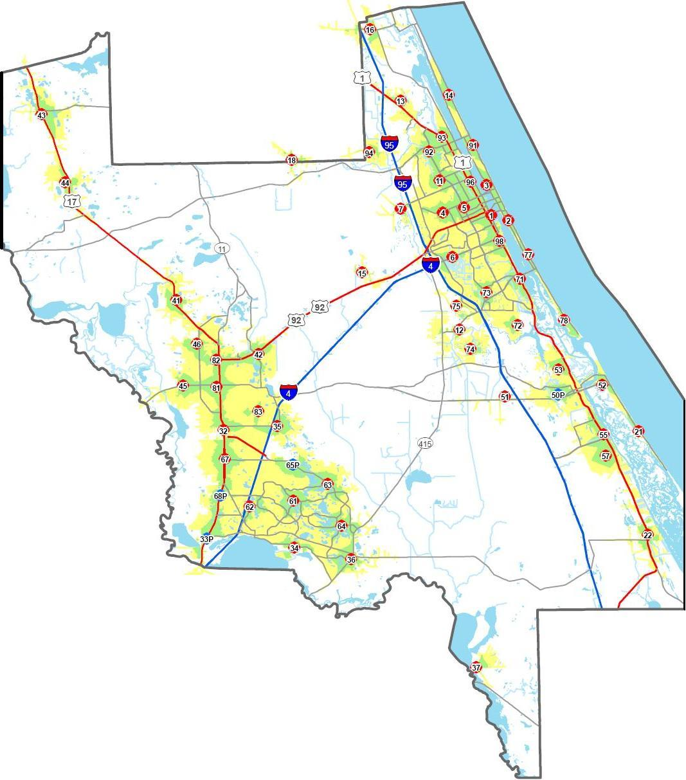
Re
4 Min. Response
Green
Response
Time
8 Min. Response
Yellow

Slide 9
Population since 2002
+ 8%

Slide 10
Cost of service since 2002
+ 93%

Slide 11
Then….now….
2002 fire/rescue operating cost: $43,000,000
2010 fire/rescue operating cost: $85,000,000

Slide 12
.......and in the future
At present rate of spending for fire/rescue, future costs could grow significantly.

Slide 13
Welcome to the 21st Century
81,270 fire/rescue incidents
Fires of any kind = 2.6%
Structural fires, less than 1%

Slide 14
…and by the numbers
79,157 non-fire incidents
1,633 fire calls of any kind
488 fire calls for structure fires
3 fatalities 2009

Slide 15
Emergency Medical Services
Paramedic saturation
325 paramedics
(significantly more than needed)

Slide 16
Emergency Medical Services
Emergency medical treatment (paramedics) as approved by the medical director
Often more paramedics respond than required
No administrative control of additional paramedic certifications
Certifications mean up to $5,000 annual pay premiums for paramedics

Slide 17
DeLand EMS Model
Fire/Rescue has NO paramedics
Uses EVAC paramedics
Has one of the County’s best cardio rescue records

Slide 18
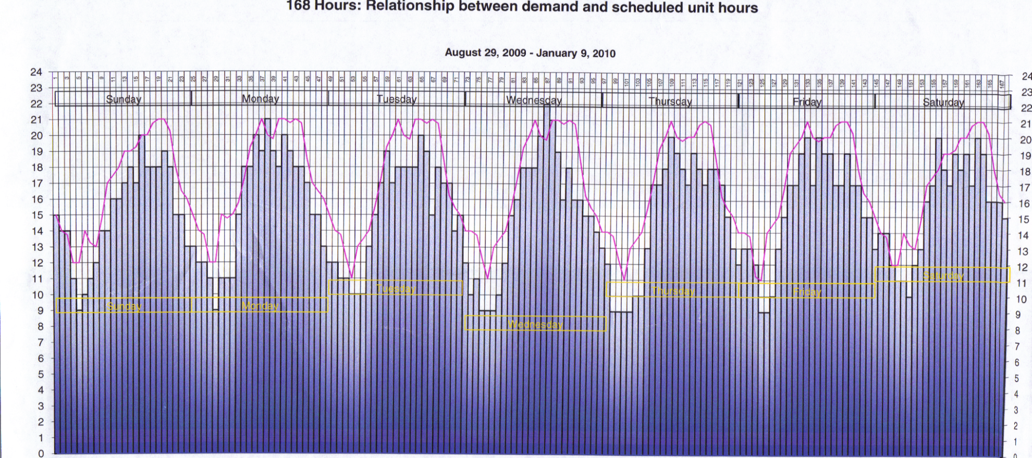
Incident DEMAND vs. Staff SUPPLY
EVAC Staff Levels Reduced When Incident Demand Is Low
Fire/Rescue uses level
staffing
Incident Demand Is High In The Afternoons and Early Evenings

Slide 19
EMS costs of 24/7 vigilance
Fire/Rescue transport costs (including pension) are higher than EVAC

Slide 20
EMS costs of 24/7 vigilance
EVAC |  | Fire
4 Shifts | 24/7 | 3 Shifts
$29.60 | Hourly Starting Per Unit | $24.70
$264,742 | Annual | $221,559
$280,624 | Annual with Pension | $246,149 – $303,535
$313,511 | Hourly mid-point wage with pension | $358,645
When factoring in expensive Fire/Rescue equipment, the cost – relative to EVAC – is even higher.

Slide 21
Taxpayer contribution to pensions
Edgewater = 11.46%
DeLand = 15.20%
Daytona Beach Shores, Orange City, Ponce Inlet, South Daytona and Volusia County = 21.33%
Ormond Beach = 27.40%

Slide 22
Taxpayer contribution to pensions
Holly Hill = 27.81%
Daytona Beach = 30.56%
Port Orange = 36.90%
New Smyrna Beach =37.00%

Slide 23
Unfunded Liability
Increasing pension cost have created large unfunded liabilities.

Slide 24
Unfunded Liability
Unfunded liability is the actual pension expense that will occur in the future and there is no present funding to cover the cost.

Slide 25
Times Have Changed
In the early 1900s
Buildings were made of highly flammable materials
Fire suppression systems did not exist
Asbestos and other hazardous building materials were common
Fire/Rescue Personnel
High mortality rate on the job
Suffered major respiratory illnesses
Average life expectancy in the mid-50s
On average collected pension for less than 10 years
Background Clarification – Not Part Of The Report

Slide 26
In The 21st Century
Construction Practices Have Changed
Hazardous building materials are prohibited
Building materials are more fire resistant
Fire suppression systems are more pervasive
Codes prohibit hazardous building design practices
Fire/Rescue Personnel
Utilize much safer fire/rescue practices
Wear sophisticated protective gear and respirators
Now have almost identical life expectancy as the average citizen – mid to late 70’s
Background Clarification – Not Part Of The Report

Slide 27
Unfunded Liability The Perfect Storm
Fire/rescue pension benefits have increased
Recent capital market changes have decreased pension fund asset bases
Investment returns have fallen way below traditional actuarial return rate assumptions
Fire/rescue personnel are living longer and collecting pensions for a longer period
Fewer active personnel are paying into the system
Multiple small local unions create competition among municipalities exacerbating the problem
Background Clarification – Not Part Of The Report

Slide 28
Unfunded Liability
Edgewater = $675,783
Holly Hill = $1,437,122
DeLand = $1,500,000
Deltona = $3,763,710

Slide 29
Unfunded Liability
Ormond Beach = $7,458,000
New Smyrna Beach = $7,772,941
Port Orange = $17,846,82
Daytona Beach = $20,196,624

Slide 30
Unfunded Liability
NOTE
In 1999, all
pensions are
believed to
have been
essentially
fully funded
$60,650,503
Total

Slide 31
Fire/Rescue Pension Costs
Port Orange
EXAMPLE
From the
report given
to the city
impasse
hearing by
IAFF
Local 3118

Slide 32
Fragmented System Consequences
Larger fire/rescue departments are subsidizing departments in smaller adjacent cities

Slide 33
Fragmented System Consequences
Due to fragmented fire/rescue system, EVAC is the most cost effective solution for transport

Slide 34
Fragmented System Consequences
Fire/rescue level of service and cost vary significantly in different areas of the county

Slide 35
Fire/Rescue Cost Variations

Slide 36
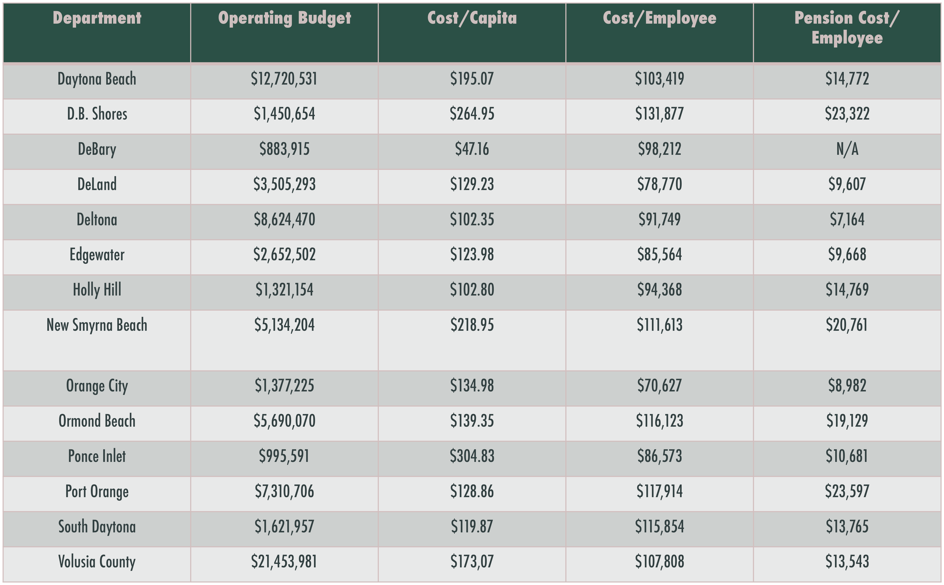
Fire/Rescue Staff Cost Comparisons

Slide 37
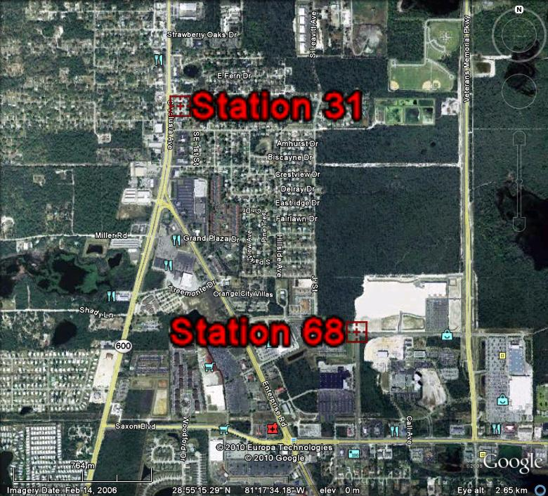
Fire stations are not optimally located due to juristictional boundaries
Orange City
1 Mile
Apart
1 mile apart
Orange City
Stations need not be closer than 3 miles
Stations
need not be
closer than
three miles

Slide 38
Unification saves MILLION$
Eliminate duplicate staffs
Eliminate 2 fire stations
Savings = $5,700,000
(annually)

Slide 39
Unification saves MILLION$
Immediate 5% savings on overhead in cities

Slide 40
Unification saves MILLION$
Total savings would grow over time
This report assumes:
…no firefighter layoffs
…staff reductions through attrition
…existing vested benefits preserved

Slide 41
Unification = Efficiencies
Consolidate 911 dispatch
Reduce paramedic overstaffing
Dispatch protocol = most appropriate unit
Countywide EVAC & Fire/Rescue merger should occur

Slide 42
Fire/Rescue transport is NOT cost effective without unification
Boundaries create inefficiencies
Only EVAC staffing model is based on flexible demand
Fire/Rescue staffing based on constant highest level demand model
EVAC can locate units based on seasonal demand

Slide 43
Other elements of this study
Although a single county-wide DEPENDENT district is recommended….
- Single INDEPENDENT district is summarized in the report but is less cost effective
- Possible multiple regional districts are discussed as a less cost effective strategy to deal with historical parochialism

Slide 44
Other elements of this study
Florida statute authority for merger options are reviewed in legal memorandum
The study includes 23 specific recommendations

Slide 45
Key recommendations
Merge all municipal fire/rescue departments with Volusia County as a DEPENDENT fire district
Merge all 911 dispatch resources under Volusia County Sheriff’s Office
Close 2 fire/rescue stations (#23 and #31)
Relocate 2 stations (#33 and #68)

Slide 46
Key recommendations
Create a protocol where fire departments whose first responder vehicles have transport capability could transport patients under specific conditions approved by medical director

Slide 47
Overall Conclusion
The citizens of Volusia County could benefit from equal or better fire/rescue EMS services while reducing taxpayer costs by unifying these services into a single county-wide organization under a DEPENDENT district.

Slide 48
COUNTYWIDE FIRE & RESCUE SERVICES STUDY
COMMISSIONED BY:
The Civic League of the Halifax Area
For a copy of this presentation and the full report
go to:
www.CivicLeagueHalifaxArea.org

